Slide 1

Jenkins Automation

Slide 2

Overview
Jenkins is an open source automation server. It helps automate the parts of software development related to building, testing, and deploying, facilitating continuous integration and continuous delivery. It is a server-based system that runs in servlet containers such as Apache Tomcat

Slide 3

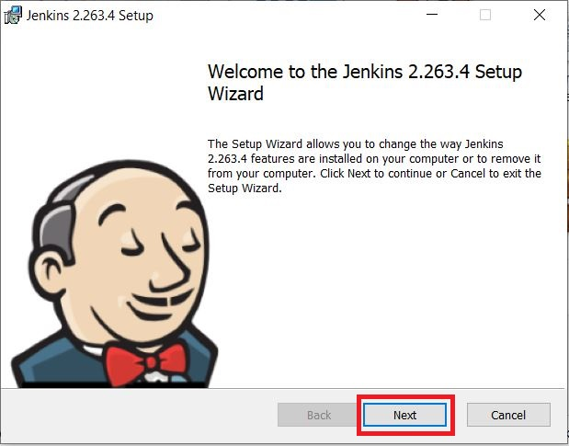
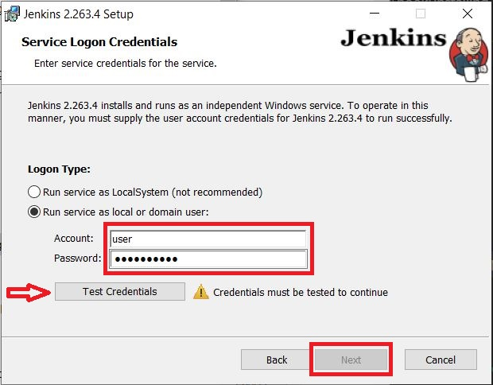
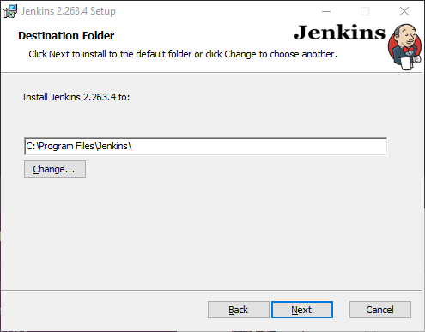
Jenkins Installation
2.Select the destination folder to store your Jenkins Installation and click Next to continue.
01
1.On opening the Windows Installer, an Installation Setup Wizard appears, Click Next on the Setup Wizard to start your installation.
3.To run Jenkins service using a local or domain user, specify the domain user name and password with which you want to run Jenkins, click on Test Credentials to test your domain credentials and click on Next.

Slide 4
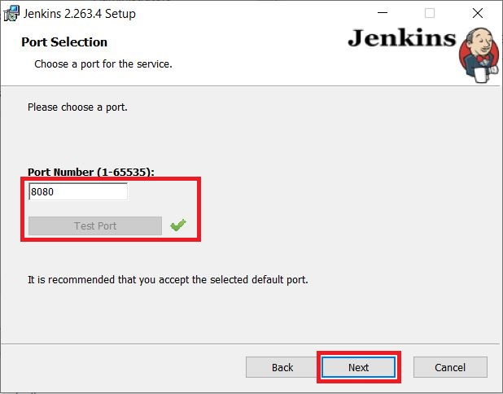
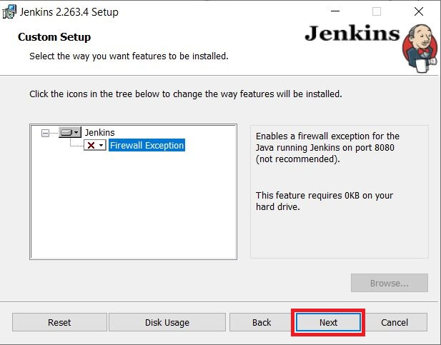
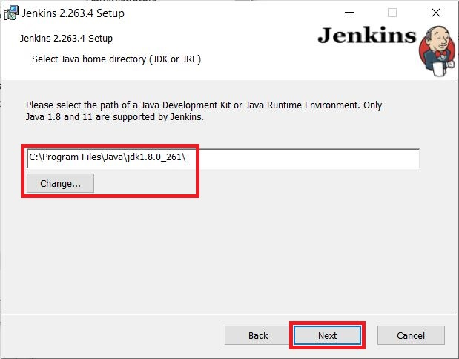
5.The installation process checks for Java on your machine and prefills the dialog with the Java home directory. If the needed Java version is not installed on your machine, you will be prompted to install it.
Once your Java home directory has been selected, click on Next to continue.
01
4.Specify the port on which Jenkins will be running, Test Port button to validate whether the specified port if free on your machine or not. Consequently, if the port is free, it will show a green tick mark as shown above, then click on Next.
6.Select other services that need to be installed with Jenkins and click on Next.

Slide 5
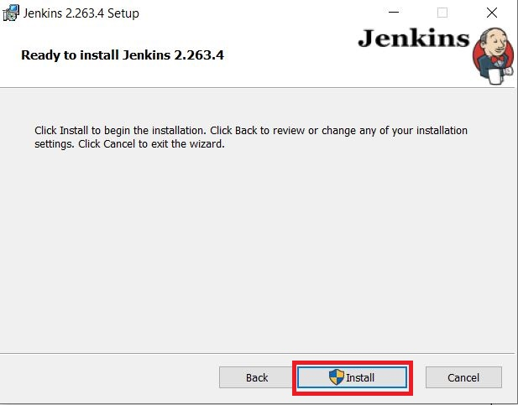
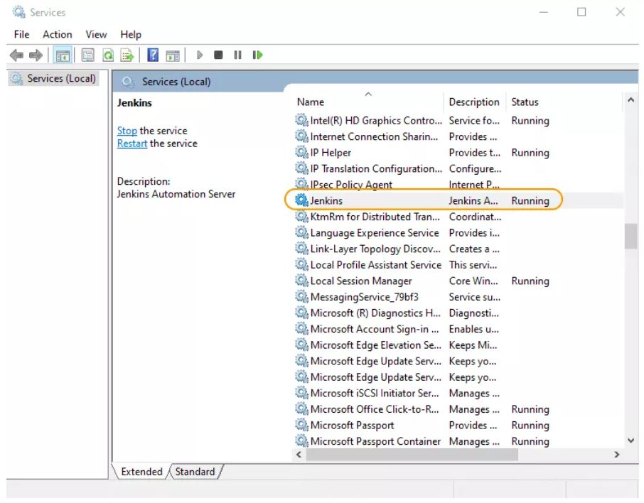
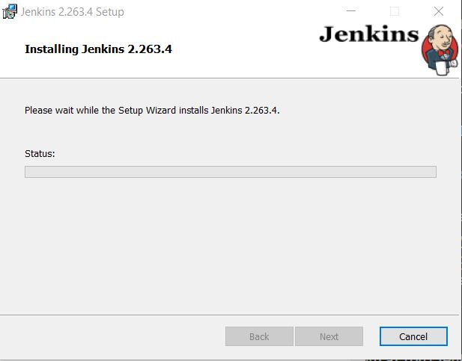
Installation Progress
01
7.Click on the Install button to start the installation of Jenkins.
8.Once the installation completes, click on Finish to complete the installation. Jenkins will be installed as a Windows Service. You can validate this by browsing the services section, as shown above:

Slide 6
Jenkins Implementation
Adding Root POM path
1
2
Setting Configuration
3
Building the project on Jenkins Server

Slide 7
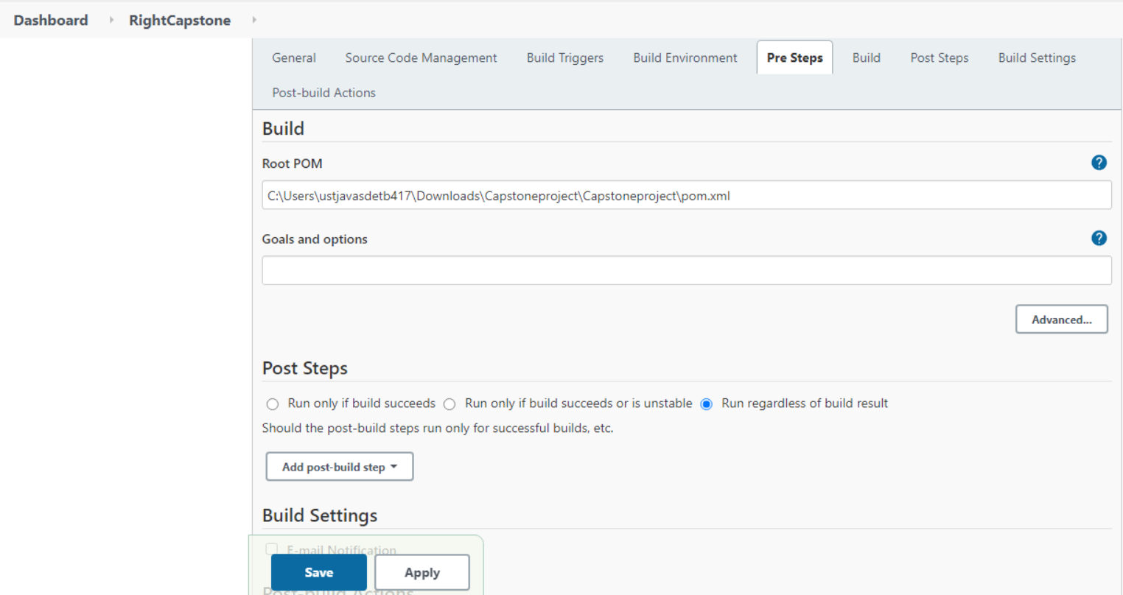
POM ROOT PATH
Take the project Right capstone in the Jenkins.
Click on configure and paste the root of pom file in the build environment.

Slide 8
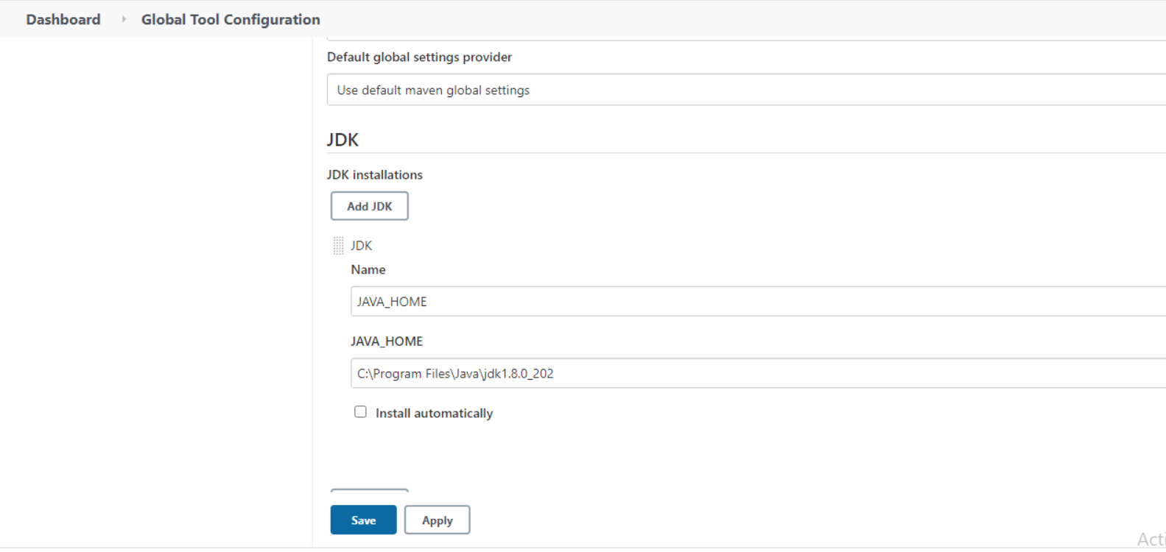
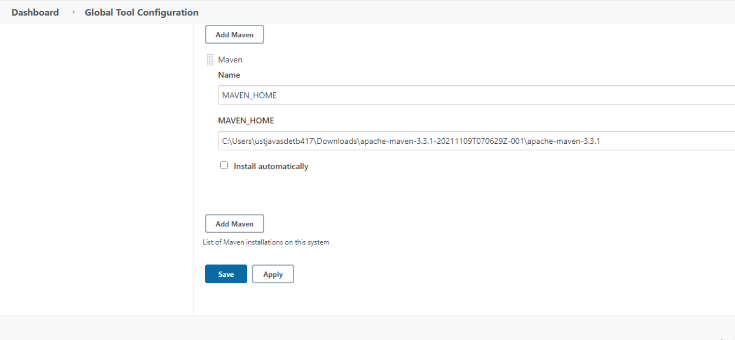
CONFIGURATION
Click on manage Jenkins🡪
Global tool Configuration🡪
Give the JDK Path🡪then, give the path of apache maven 3.3.1🡪
Save and Apply.

Slide 9
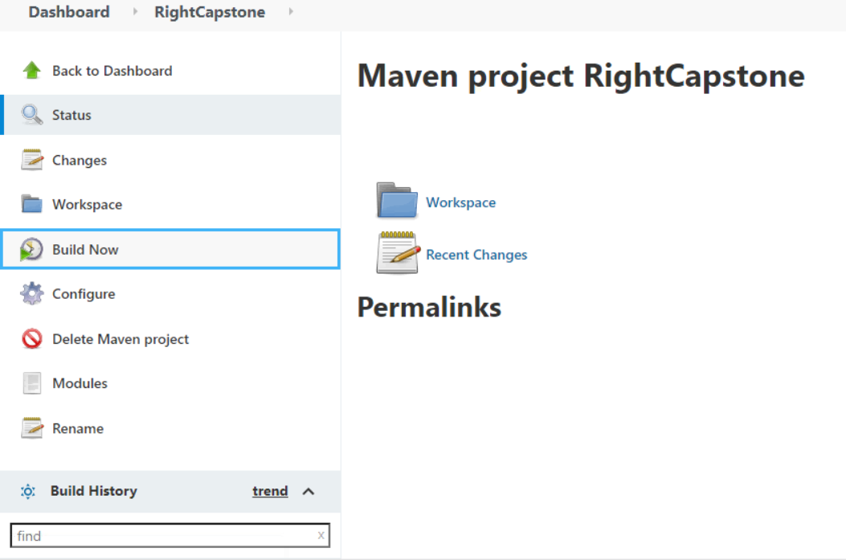
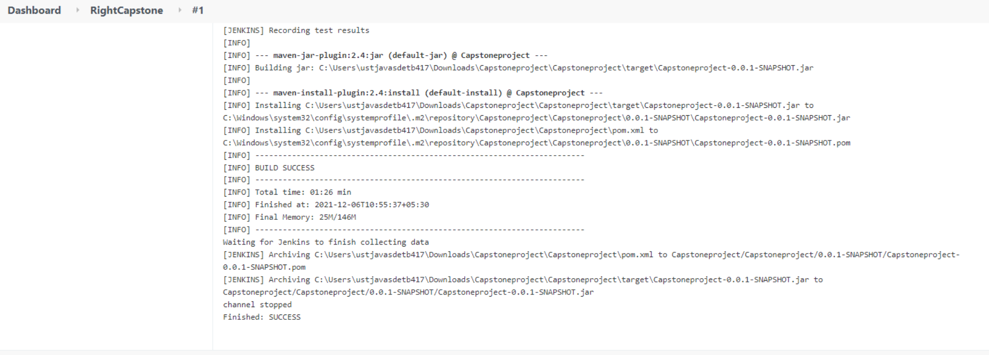
BUILDING PROJECT
Select the project🡪
Buildnow🡪
Click on the console output.

Slide 10
Thank you.

